Slide 1
Calculation of MIPS Parameter

Slide 2
One alternative way to measure CPU performance is MIPS, or million instructions per
second.
For a given program, MIPS is given by
MIPS = Instruction count/Execution time* 10^6 (1)
Since,
Execution time = Instruction count*CPI/Clock rate
(2)

Slide 3
Equation 1 becomes
MIPS = Clock rate/(CPI *10^6) (3)
Since MIPS is a rate of operations per unit time, CPU performance can be specied
as the inverse of execution time, with faster machines having a higher MIPS rating.
However, according to the Patterson and Hennessy, there are problems with using MIPS as a performance metric.

Slide 4
MIPS is dependent on the instruction set of the CPU, making it difficult to compare the MIPS ratings of processors with different instruction sets.
MIPS can vary inversely to performance.

Slide 5
Under what conditions can the MIPS rating be used to
compare performance of different CPUs?
• The MIPS rating is only valid to compare the performance of
different CPUs provided that the following conditions are satisfied:

Slide 6
1 The same program is used
(actually this applies to all performance metrics)
2 The same ISA is used
3 The same compiler is used
⇒ (Thus the resulting programs used to run on the CPUs and obtain the MIPS rating are identical at the machine code level including the same instruction count)

Slide 7
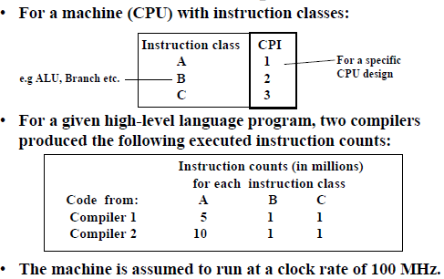
MIPS (Million Instructions Per Second) Rating

Slide 8
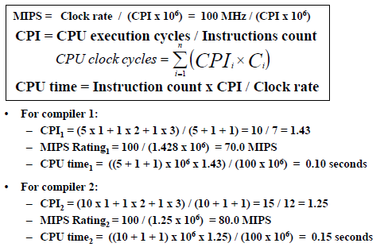
MIPS (Million Instructions Per Second) Rating

Slide 9
MIPS (Million Instructions Per Second) Rating
MIPS rating indicate that compiler 2 is better while in reality the code produced by compiler 1 is faster.

Slide 10
example:
• processor with clock frequency of 500 MHz
• 3 instruction classes A, B, C with CPI A = 1, CPI B = 2, CPI C = 3
• 2 different compilers generate (for the same program) following
instruction mixes (x 109):

Slide 11


Slide 12
• clock cycles
program1: (5 x 1 + 1 x 2 + 1 x 3) x 10^9 = 10 x 10^9
program2: (10 x 1 + 1 x 2 + 1 x 3) x 10^9 = 15 x 10^9

Slide 13
• execution times
program1: (10 x 10^9) / (500 x 106) = 20 sec
program2: (15 x 10^9) / (500 x 106) = 30 sec

Slide 14
• MIPS rates
program1: ((5 + 1 + 1) x 10^9 ) / (20 x 10^6) = 350 MIPS
program2: ((10 + 1 + 1) x 10^9) / (30 x 10^6) = 400 MIPS
program2 has a higher MIPS rate, program1 runs faster !

